Slide 1
Tuning of PID Controller for Pressure Control Application
Process Instrumentation Course Project
Group Members:-
Abhijit Pokharkar (Roll No. 12)
Prashant Rathod (Roll No. 20)
Nagesh Reure (Roll No. 22)
Vivek Rugale (Roll No. 24)
Pranjali Sagar (Roll No.25)

Slide 2
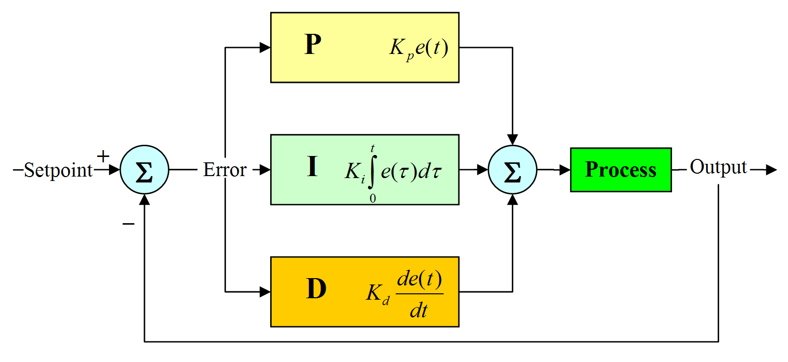

PID Controller
Continuously calculates the error between measured value and set-point.
Applies correction based on proportional, integral and derivative actions.

Slide 3
PID Control
P - Proportional term. Changes output linearly with error. Gives faster response. Constant is Kp.
I - Integral term. Output keeps changing till error is zero. Removes offset error. Constant is Ki.
D - Derivative term. Anticipates future error. Gives output if error is changing. Constant is Kd.

Slide 4

Transfer function for pressure process
First order plus dead time (FOPDT)

Slide 5
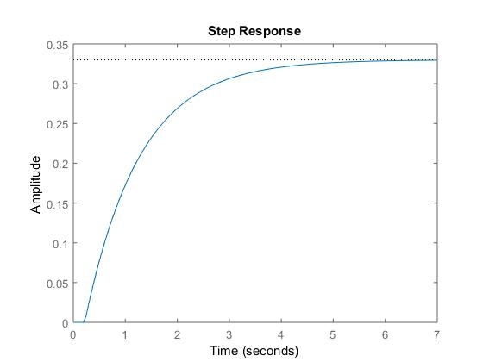
Open loop response
Rise time = 2.32 s
Settling time = 4.35 s
Final value = 0.33

Slide 6
Tuning of PID controller
Finding the values of Kp, Ki and Kd such that system achieves desired performance.
Methods used for tuning -
Manual tuning
MATLAB PID Tuner
Ziegler-Nichols method

Slide 7
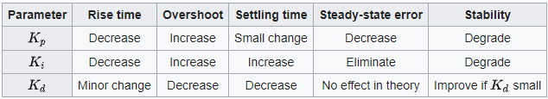
Manual Tuning
Set Ki, kd to zero
Increase Kp till system oscillates
Increase Ki to eliminate offset
Increase Kd to reduce overshoot

Slide 8
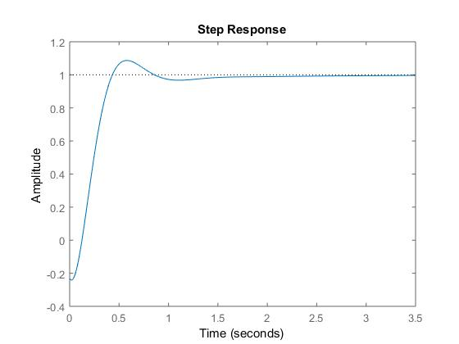
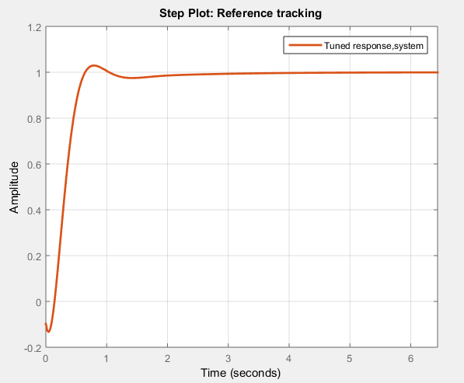
Manual Tuning
MATLAB PID Tuner
Kp = 14, Ki = 10.5, Kd = 0.6
Rise time = 0.27 s
Settling time = 1.3 s
Overshoot = 8.69%
Kp = 12.2, Ki = 8.3, Kd = 0.6
Rise time = 0.34 s
Settling time = 1.74 s
Overshoot = 0.964%

Slide 9
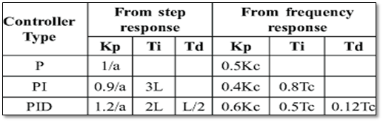
Ziegler-Nichols Method
Here there are two process for finding Kp, Ki, and Kd value in ziegler nichols method:
From step response
From frequency response

Slide 10
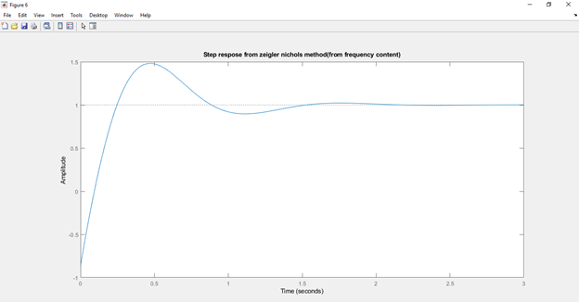
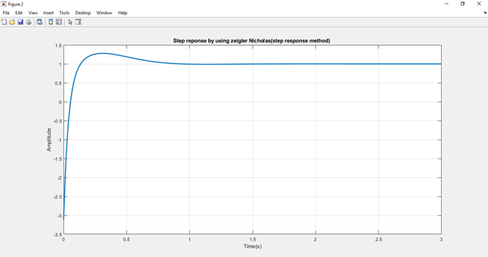
Ziegler-Nichols Method Output response
Kp = 18.9, Ki = 60.1, Kd = 1.48 Kp = 26.4079, Ti= 0.3667, Td = 0.0917

Slide 11
Thank You

